Slide 1
Karabo Integrating Control, Data Acquisition, Data Management, and Data Analysis Tasks into a Single Software Framework
Burkhard Heisen
Control and Analysis Software Group – European XFEL GmbH
European XFEL User’s Meeting
Hamburg, January 28, 2015
Notes:
How to edit the title slide
Upper area: Title of your talk, max. 2 rows of the defined size (55 pt)
Lower area (subtitle): Conference/meeting/workshop, location, date, your name and affiliation, max. 4 rows of the defined size (32 pt)
Change the partner logos or add others in the last row.

Slide 2
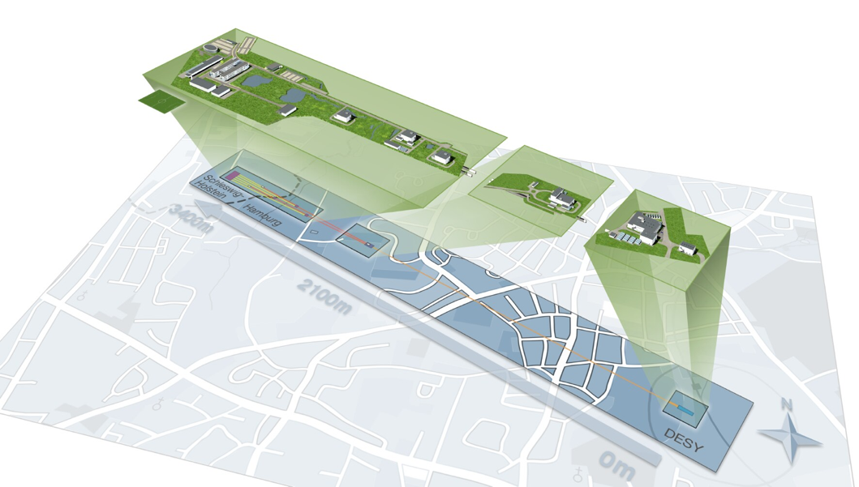

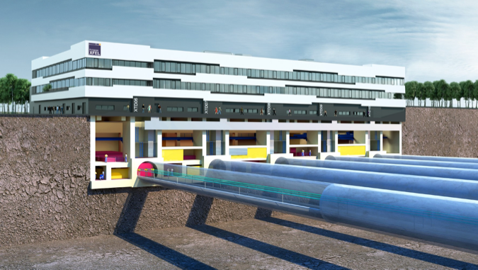
Karabo will be used at the photon beamlines
Why?
One software framework, one user interface, one programming interface
Less learning, less teaching, less maintenance, less changes, less conversions, more freedom
Karabo
DOOCS Tine EPICS
Why else?
Our requirements are different to those of classical synchrotron or high energy physics experiments
We invest a lot of money for better science, a small fraction is for better software

Slide 3



The vision – From a user perspective
A typical use case:
Control
drive hardware and complex experiments
monitor variables & trigger alarms
DAQ
data readout
online processing
quality monitoring (vetoing)
Sample Injector
allow some control & show hardware status
Accelerator
Undulator
Beam Transport
show online data whilst running
DM
storage of experiment & control data
data access, authentication authorization etc.
setup computation & show scientific results
DAQ
Control
DA
processing pipelines
distributed and GPU computing
specific algorithms (e.g. reconstruction)
DM
DA
Tight integration of applications
Notes:
In order to understand what software we need image a prospective user wanting to conduct an experiment at XFEL in 2015!
300 images per train = 1.000.000 images after 5 min 30 s
512 image per train = 1.000.000 images after 3 min 15 s
~ 4 TB dataset
Tuning means:
Visualize whether any sample get hit. Re-configure injector.
Start, stop acquisition etc…
Starting experiment means:
Get detector, injector etc. ready to go (control)
Prepare storage system for sinking data with 10 GB/s

Slide 4
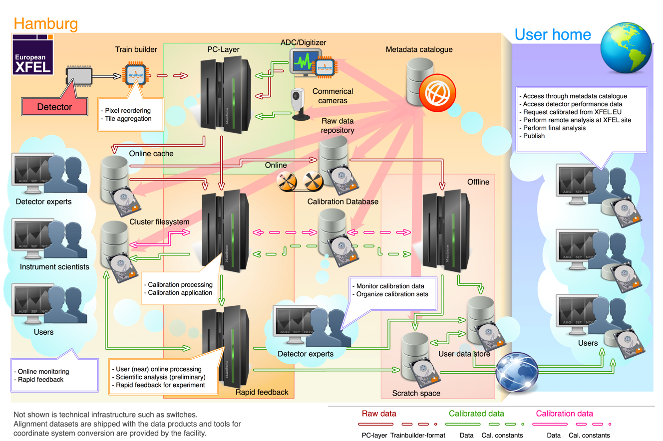
The vision – From a data perspective
Courtesy of S. Hauf

Slide 5
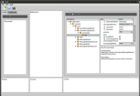



Karabo is a “device” based system
DAQ
Equipment
Equipment
Control
DAQ
Equipment
User interface(s)
Service
Device
e.g. 2D-detectors (AGIPD, LPD, DSSC)
e.g. motor, pump, valve, sensor
DAQ
Control
e.g. commercial camera
e.g. calibrationManager, configurationManager
Data Storage
Node
DM
DA
Message Broker
Composite
Device
Analysis
Node
e.g. storage of data from runs
e.g. calibrationManager, projectManager, GUI server
e.g. complex detector motion control

Slide 6
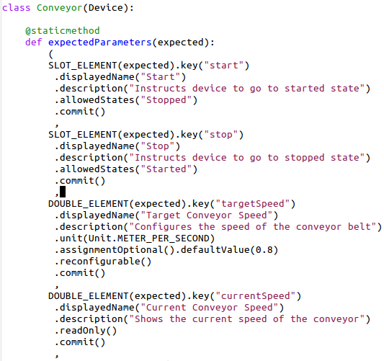
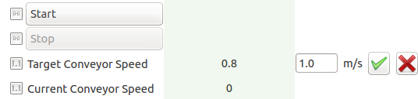
Device – As controllable object
Device classes can be loaded at runtime (plugin technology)
Can be written in C++ or Python
Devices completely describe themselves. Allows automatic GUI creation
Runtime-extension of properties, commands and attributes is possible
Hierarchical groupings of parameters are possible
Any property setting or command execution can be restricted to a set of allowed states
The GUI reflects state limitations by enabling/disabling buttons and properties dynamically
Command
Attribute
Property
auto generated

Slide 7
Device – As pipeline module
Devices can act as modules of a streaming data pipeline
Configurable generic input/output channels on devices
Developers just need to code the onData and (optionally) the onEndOfStream method
IO system is decoupled from processing system (process whilst transferring data)
Input channels configure whether they share the sent data amongst all input channels or whether they receive a copy of each data token
Broker-based communication transparently establishes a point-to-point connection
Any pipeline device has full access to the live control-system (feedbacks easily possible)
Memory
Multi-threaded processing
TCP
Distributed processing

Slide 8



Pipelines support load balancing
CPU
IO whilst computing
Notification about new data possible to obtain
Pixel parallel processing
(one GPU thread per pixel)
GPU
Once resources are available, input channels request new data from connected output channels
Configurable output channel behavior in case no input currently available: error, queue, wait, drop

Slide 9
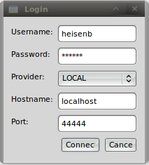
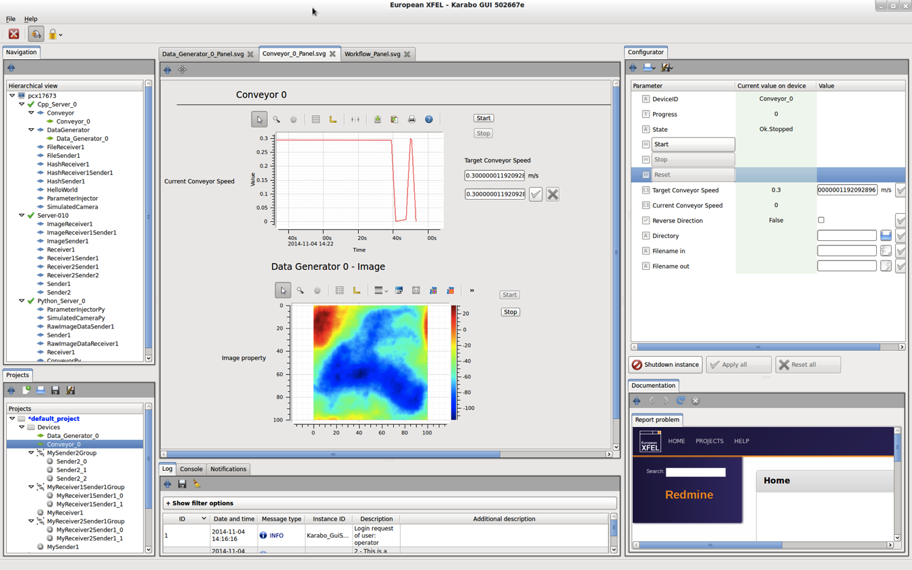
Graphical interface - Overview
Live Navigation
drag & drop
Configuration
Custom Scene
User centric and access-controlled setup (login at startup)
Dock-able and resizable multi-panel, all-in-one user interface
Live navigation showing all device-servers, plugins, and device instances
Automatically generated configuration panel, allowing to read/write/execute
PowerPoint like, drag & droppable, tabbed custom scene
Project panel for persisting configurations, macros, scenes, resources, etc.
Centralized logging information, notification handling, documentation, etc.
Log Messages
Interactive Command Line
Documentation
Bug Reporting
Project

Slide 10
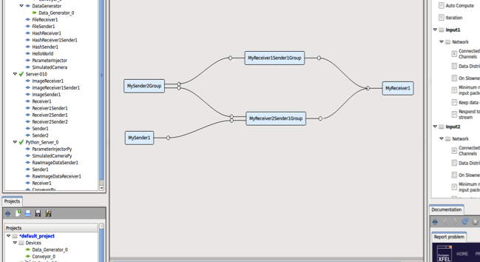
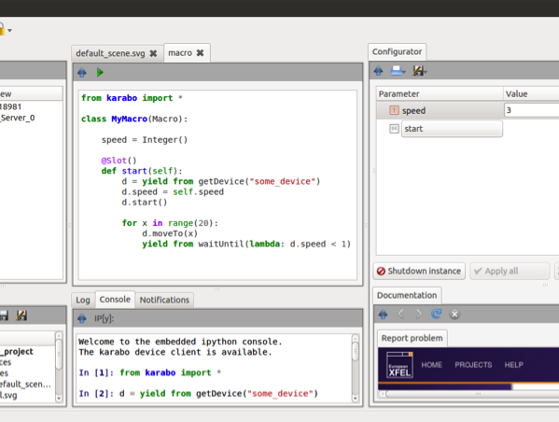
Graphical interface – Pipelines and Macros
Pipeline configuration
Whole devices can be dragged (from left side) as pipeline nodes
Dragging individual parameters from right is still possible (e.g. control parameters)
Devices can be grouped and edited as group (connections and configurations)
Macro editing
Editing and execution from within GUI or using regular terminal
Macro parameters and functions integrate automatically into configuration panel
Macro API can be interactively executed in embedded IPython interpreter
Macro writing is something we hope our users can easily do themselves
drag & drop
Courtesy of K. Weger
Courtesy of M. Teichmann

Slide 11
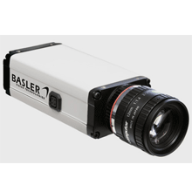

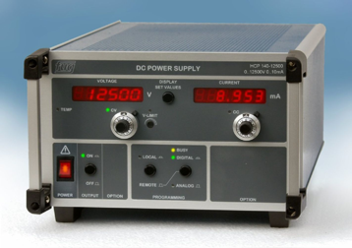
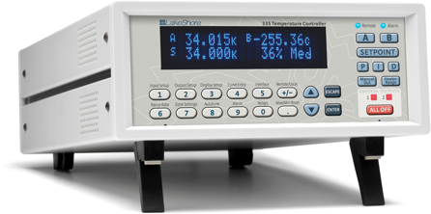
Cameras, power supplies, heaters…
Supported standards
GenICam (generic interface for cameras) - industry standard
Lima (library for image acquisition) – ESRF project
SPCI (Standard Commands for Programmable Instruments)
Cameras
Basler (all GigE), Photonic Science (sCMOS)
IMPERX (Bobcat B4020), Andor (Neo)
AVT (all Prosilica), Axis (all)
Other devices
FUG, Heinziger (power supplies), TEM (beam lock)
Amphos (laser power stage)
EnergyMax (laser sensors)
Lakeshore (heater), STS (spectrometer)

Slide 12

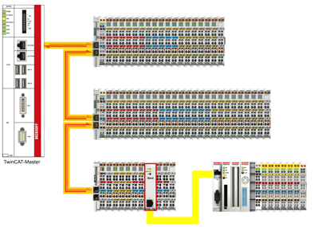

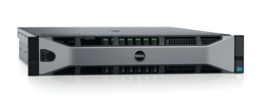
Motors, pumps, valves… and real-time control
Karabo itself does not directly provide real-time processes/communications -> uses Beckhoff layer
Beckhoff PLC-firmware blocks are mapped to Karabo devices and can be auto-generated from PLC self-description
Integrated devices (now extending to different vendors):
Turbo-, ion-, and scroll-pumps
Valves, gauges, temperature sensors
Stepper-, piezo- and servo-motors
Motor1
Motor2
Pump1
Beck
Com
Gather/Scatter
TCP (own protocol)
PLC-CPU
EtherCAT
Motor1
Motor2
Pump1
Courtesy of P. Geßler

Slide 13
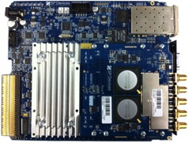
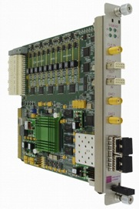

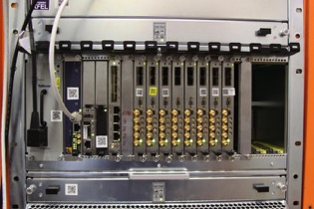
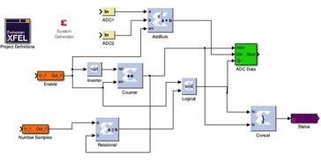


Digitizers, ADCs, Timing interfaces…
Digitizers (used in XGMs, PESs)
Fast ADCs (analog to digital converters)
Timing interfaces (in progress)
Simulink/Matlab based FPGA programming framework with Karabo integration
ADQ 412 (SP-Devices)
SIS8300 – ADC AMC
(Struck Innovative Systems)
MicroTCA crate
XML FILE
User Registers and Memories Description
Software
(Karabo)
Source Files
with script
Final Design
Bus protocol logic generated automatically
Courtesy of P. Geßler
FPGA compiler/tool

Slide 14
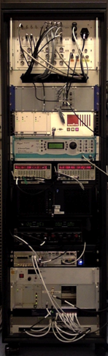
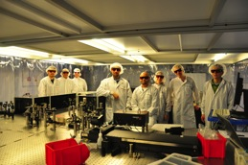
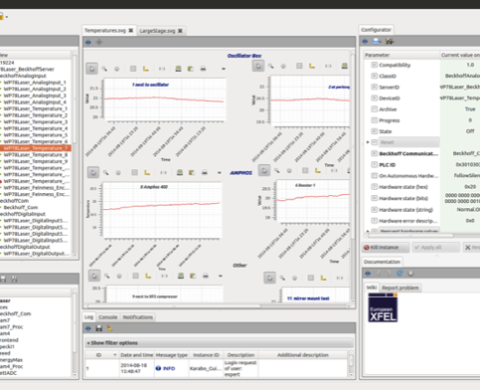
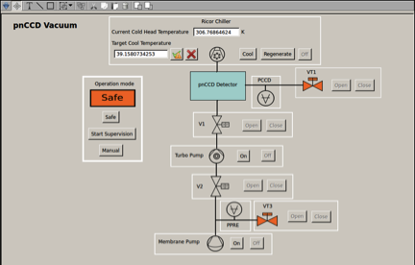
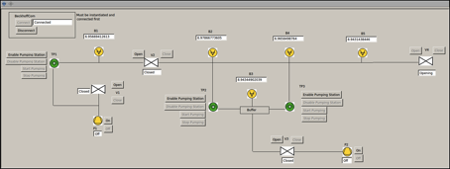
Karabo in use – Control systems
Pump probe laser setup (laser group)
Runs burst mode according to XFEL (4.5 MHz intra burst)
Control of motors, cameras, MicroTCA based ADCs, image processing devices
Controls pulse arrival time in a closed loop (motor position correction depending on ADC signal)
Vacuum setups
Control of e.g. differential pumping sections
Typically includes several valves, pumps, and PLC-interlocks for safety
Pressure monitoring and history trend line plotting
Courtesy of L. Wissmann

Slide 15
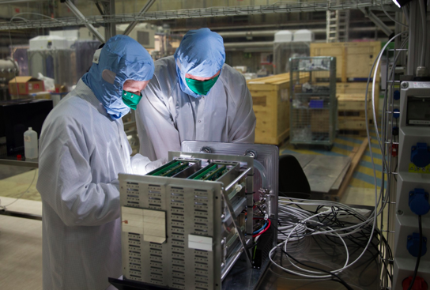
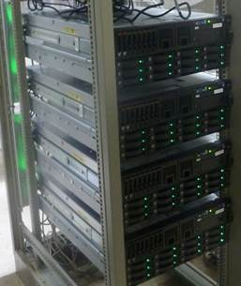
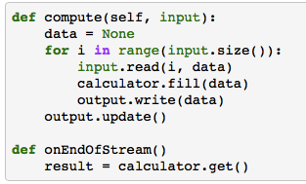

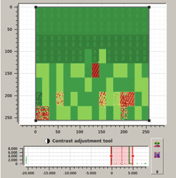


Karabo in use – DAQ and data management
Large Pixel Detector (LPD) prototype testing
Detector control (Python based)
Data acquisition and storage (HDF5) (C++)
Online calibration processing, analysis and correction (Python and CUDA based)
Interaction with calibration database (Oracle)
Full integrated run control expected in summer
LPD quadrant prototype
Server setup necessary to harvest the data
Visualization of a LPD quadrant in Karabo
Courtesy of S. Hauf

Slide 16
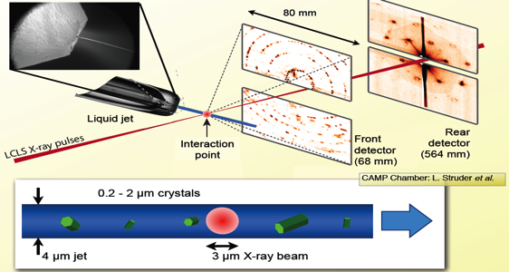
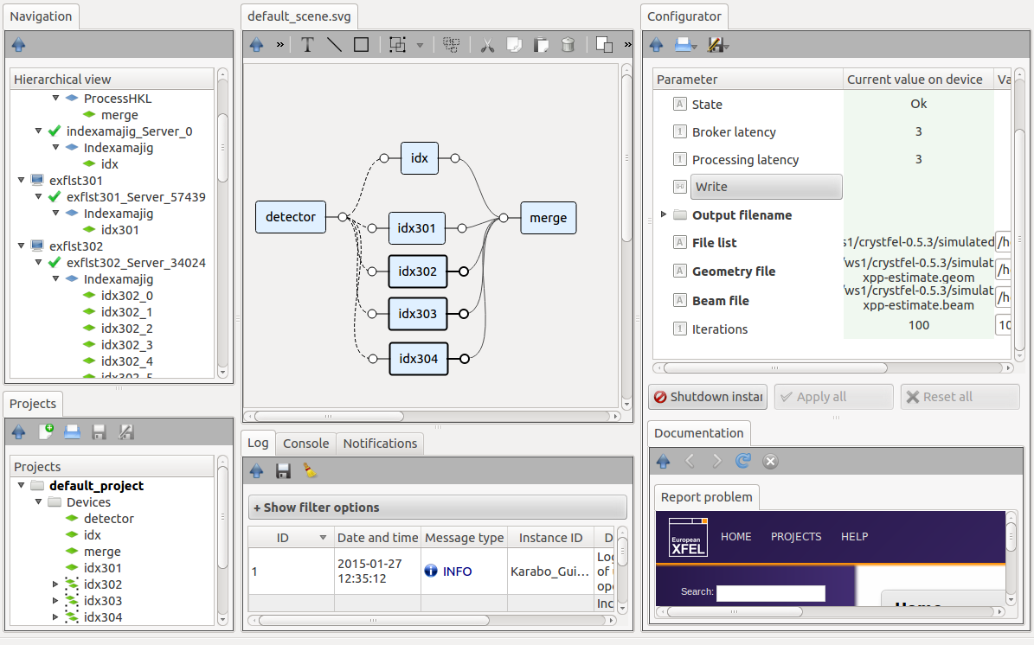
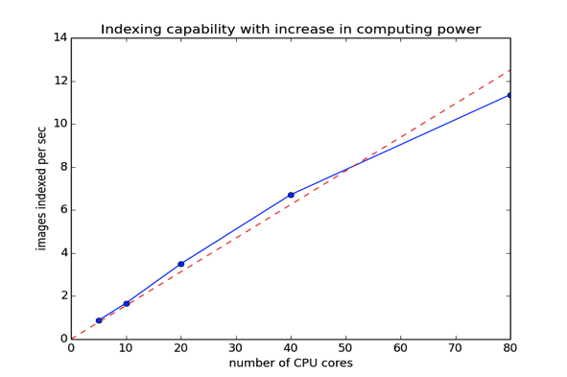
Karabo in use – Data Analysis
Serial femtosecond crystallography
Aim is to build an SFX data processing pipeline to match the high repetition rate offered at the European XFEL
5000 images/sec
@ 2.3 sec per image
30% hit rate
3500 cores needed
Linear speed up with number of cores!
Courtesy of C. Yoon

Slide 17
Conclusions and Acknowledgements
K. Weger
M. Teichmann
S. Esenov
A. Parenti
A. Beckmann
G. Giambartolomei
A. Silenzi
J. Szuba
M. Kumar
L. Maia
D. Boukhelef
S. Hauf
C. Yoon
A. Münnich
L. Wissmann
P. Geßler
K. Wrona
C. Youngman
… and many more
Karabo is unique in seamlessly combining instrument control, experiment configuration, streamed data analysis and visualization
Its is designed for being extended easily and will be ready to execute your algorithms during the experiments
Karabo proves capable to run complex installations even today
Currently the focus is on supporting our in-house users and external collaborators -> access is on request
Public release of the core system under the GNU GPL license will follow in 2015
Stay tuned…

Slide 18

Thank you for your kind attention.
Contact details: burkhard.heisen@xfel.eu

